Slide 1

DC Motor Concept
EV

Slide 2
Contents
Force on a current carrying conductor
Concept
Animated Video
Determine the direction in which a current-carrying wire experiences a force in an external magnetic field
Calculate the force on a current-carrying wire in an external magnetic field

Slide 3
Concept
Moving charges experience a force in a magnetic field.
If these moving charges are in a wire—that is, if the wire is carrying a current—the wire should also experience a force.
Two separate effects here that interact closely:
A current-carrying wire generates a magnetic field.
The magnetic field exerts a force on the current-carrying wire.

Slide 4
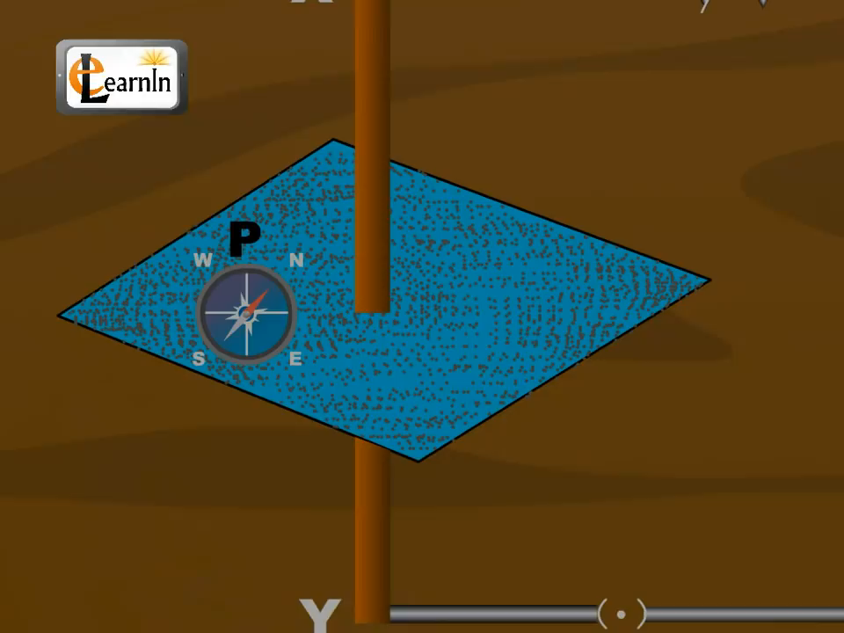
Video

Slide 5
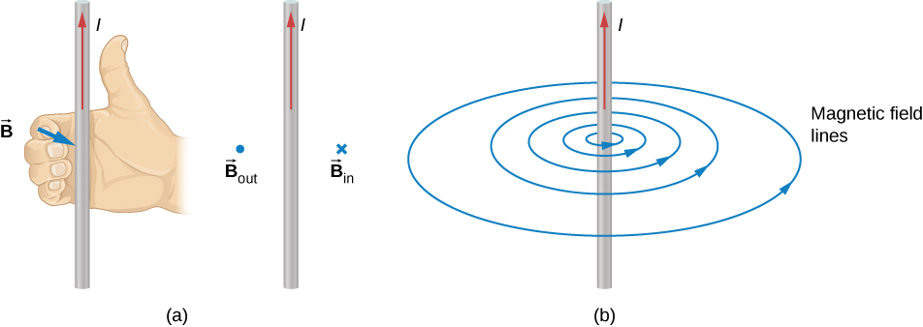
Magnetic field by Current Carrying Conductors
A wire carrying an electrical current caused a nearby compass to deflect.
A connection was established that electrical currents produce magnetic fields.
The compass needle near the wire experiences a force that aligns the needle tangent to a circle around the wire.
Therefore, a current-carrying wire produces circular loops of magnetic field.
To determine the direction of the magnetic field generated from a wire, we use a second right-hand rule.
In RHR-2, your thumb points in the direction of the current while your fingers wrap around the wire, pointing in the direction of the magnetic field produced.

Slide 6
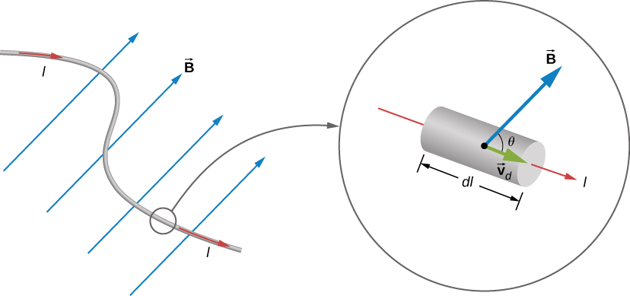

Calculation of Force
The force by current carrying conductor in magnetic field is given by
$F=BIL Sinθ$

Slide 7
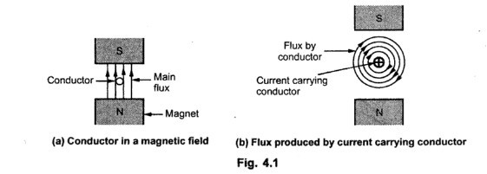
Visualization

Slide 8
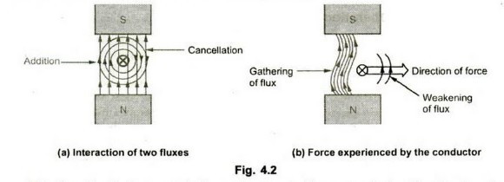
Visualization

